Slide 1
Introduction To Neural Networks and AI.
By Mustafa Behrainwala

Slide 2
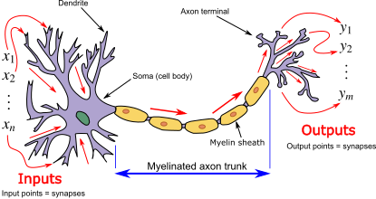
What is a Neuron?
Neuron in an AI
Input
Output
Weight

Slide 3
A Simple Linear Regression Neural Network
Input 1
Weight(i1, o1)
Output 1
Weight(i1, o2)
Weight(i2, o1)
Input 2
Weight(i2, o2)
Output 2

Slide 4
What is an Artificial Neural Network?
It is a statistical model which will use the sum of the trained weights multiplied by the inputs to predict an output.
i.e. Output1=Input1*Weight1+Input2*Weight1

Slide 5
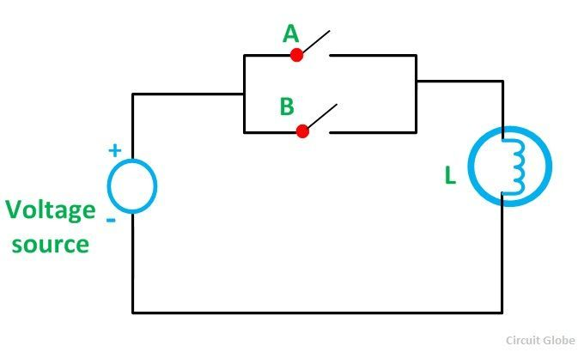
An OR gate

Slide 6
What does that mean for a neural network
We can train this simple NN to recognise any of the inputs to be high to generate a 1 on the output.
Input1
Output1
Input2
Output2

Slide 7
Activation Function in a Neural Network.
Why do we need Non-linear activation function?
A neural network without an activation function is essentially just a linear regression model. The activation function does the non-linear transformation to the input making it capable to learn and perform more complex tasks.
The different kinds of Activation function are
Sigmoid, Tangent Hyperbolic, Rectified linear unit (RelU)

Slide 8
Using a RelU
Simplest activation function
Very fast compared to others
A(x) = max(0,x)
Derivative of RelU
dA/dX = {x<=0?0:1}

Slide 9
Training the Neural Network.
To train a neural network we need to find out how much the neural network was wrong by and then tell the neural network to correct its self by that amount.
This technique is known as back propagation and the mathematical term for this is called gradient estimation.
The way a neural network will perform this is by adjusting each weight by doing a gradual gradient walk towards the minimum value required to correctly guess the output.
Remember Output1=Input1*Weight1+Input2*Weight1

Slide 10
What did we train our Network to do?
1
Input 2
Output 1
Output 2
0,0
1
Input 1

Slide 11
What did we train our OR Network to do?
1
Input 2
.9,.9
True
False
0,0
1
Input 1

Slide 12
What did we train our Age NN to do?
1
Weight
.40
Adult
Child
0,0
1
Height
.130

Slide 13
Modify our Age NN to account for Gender
1
Weight
gender
.40
Adult
Child
0,0
1
Height
.130

Slide 14
What about an XOR gate
1
Input 2
.9,.9
True
False
False
True
0,0
1
Input 1

Slide 15
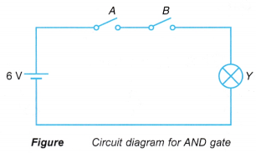
Issues with an And Gate
The neural network can only tell if the either input is +ive or 0 and have a gradient based on that.
Due to this we can never have an And gate with out neural network.

Slide 16
Building a Complete Multilayered Neural Network

Slide 17
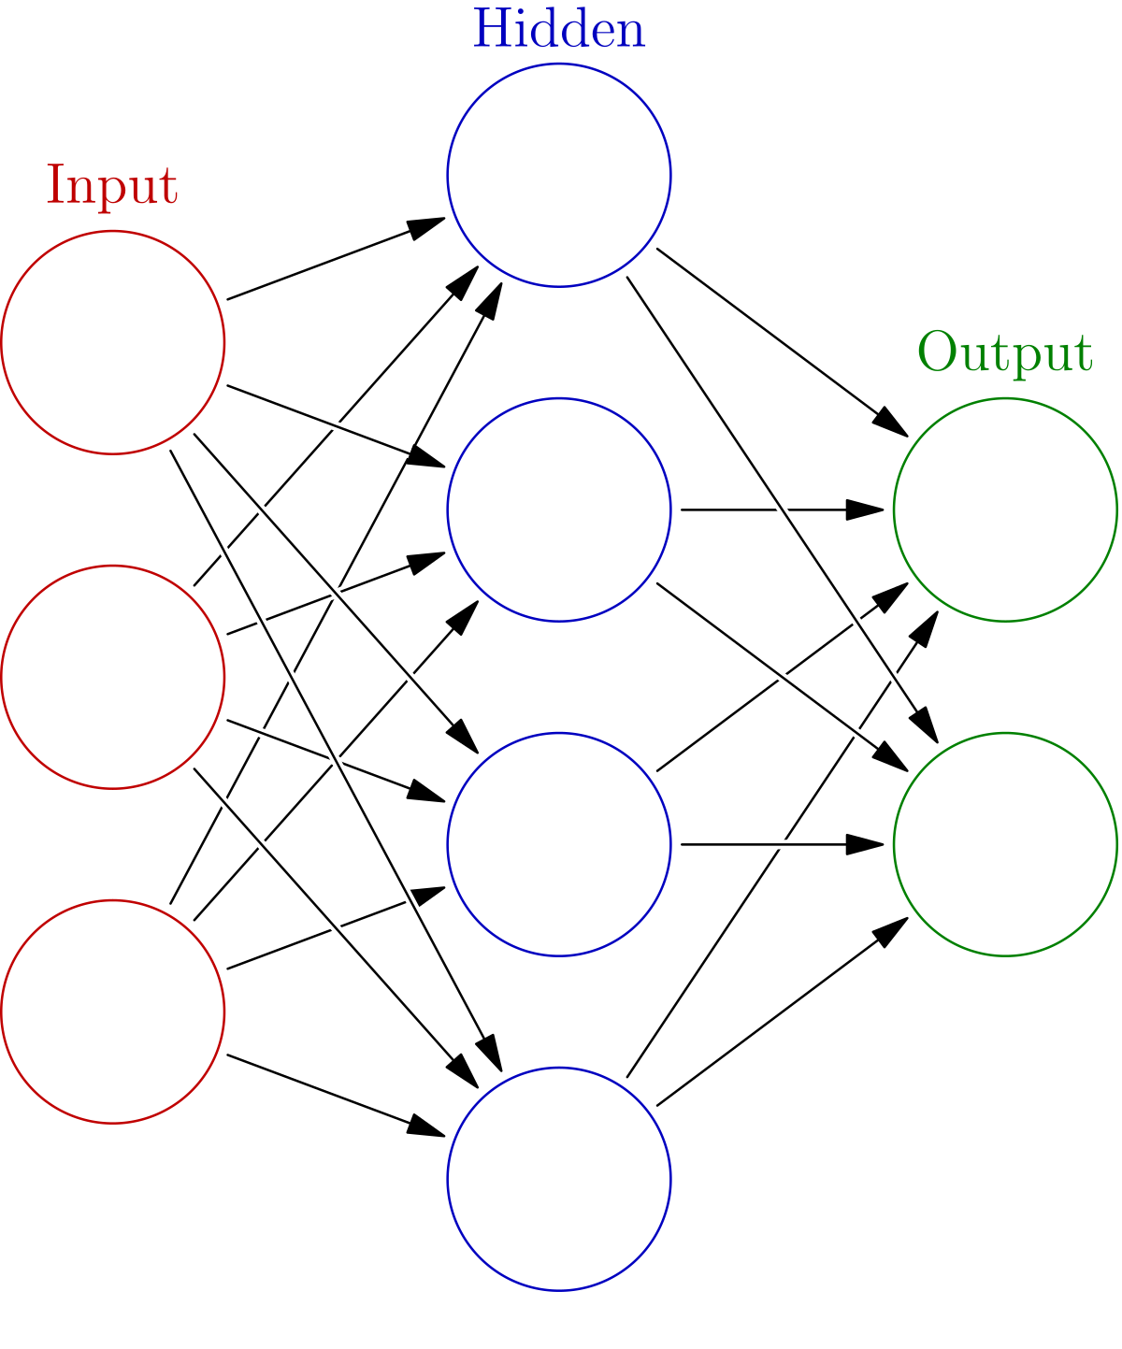
What does a complete fully connected Neural Network Look like?

Slide 18
So how do we achieve this?
During the output stage, output of the previous layer becomes the input of the next layer. This will propagate down the chain until the last output layer gives us the answer.
This technique is known as Forward Propagation.
Layer 1
Layer 2
Output
Input

Slide 19
Training a Multi layered NN
Training a multi layered NN is also known as Backpropagation.
To train the current layer we calculate the error (i.e. how much the output was off the expected value) and then based on that we can calculate the cost
Error = Output - Expected
Cost = error * dActivation(output) * input
New Weight = Current Weight - Cost
To calculate the error to be passed to the previous layer we have
Prev Layer Error = sum(error*dActivation(output) * weights)

Slide 20
Backpropagation in a Multilayered NN
Layer 1
newWeights = curWeights - cost
Expected
Input
Error(prev layer) = sum(error * dActivation(output) * weights for this output.
Error = Output - Expected
Output
Cost = error * dActivation(output) * input

Slide 21
What is bias in a neural network?
We need to introduce a bias into the system to handle scenarios when weights become 0 or the input is 0
We also need to introduce a bias when we need to deal with absolute outputs like in logic gates.
Bias is introduced by adding or subtracting a very small value from the output (e.g. 0.01)
Bias prevents the neural network from getting stuck during training.
Output = (input*weights) – 0.01
https://www.turing.com/kb/necessity-of-bias-in-neural-networks#why-is-bias-added-in-neural-networks?

Slide 22
Why is bias added in neural networks?
To understand the concept of neural network bias, let’s begin by discussing single layer neural networks.
A given neural network computes the function Y=f(X), where X and Y are feature vector and output vector, respectively, with independent components. If the given neural network has weight ‘W’ then it can also be represented as Y=f(X,W). If the dimensionality of both X and Y is equal to 1, the function can be plotted in a two-dimensional plane as below:

Slide 23
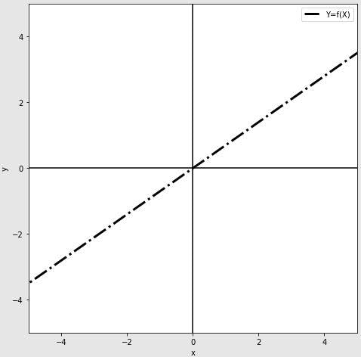
Such a neural network can approximate any linear function of the form y=mx + c. When c=0, then y=f(x)=mx and the neural network can approximate only the functions passing through origin.

Slide 24
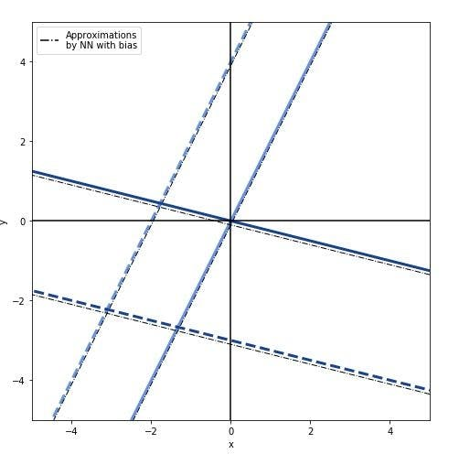
If a function includes the constant term c, it can approximate any of the linear functions in the plane.

Slide 25
Designing the Network Topology
When creating a NN we must design the network topology and decide as to how many hidden layers we need.
We also need to decide on how wide a given hidden layer will need to be.
If there are too many hidden layers this will lead to over fitting of the neural network. Ideally we only have 1 hidden layer in neural network whose width is carefully configured to be optimal.
In deep learning neural networks we have may hidden layers but they are put alongside other type of layers like convolution/pool/etc…

Slide 26
Kinds of layers in a Neural Network.
3 connected layers as Input->Hidden->Output creates a dense neural network and is the original kind of neural network.
There are other kinds of layers which can be placed either at the start or in between multiple hidden layers to create a deep learning neural network.
The different kinds of layers are.
Convolutional Layers
Recurrent Layers
Pool Layer
Batch normalization layer
Dropout layer

Slide 27
Creating an OR gate Neural Network.
For the OR gate we need to segment our neural network to distinguish between
(1, 1) (0, 1) (1, 0) and (0, 0)
As this is a simple neural segmentation no hidden layer is required.
We only need Input Layer → Output Layer

Slide 28
Creating the AND/XOR gate
For the AND/XOR gate we need to segment our neural network to distinguish between
(1,1)
(0,1) (1,0)
(0,0)
This needs to segment the data into more than 2 segments.
It will require a hidden layer to solve this.

Slide 29
AND/XOR gate topology
Hidden Layer
Output
Input 1
Input 2

Slide 30
Categorizing Age groups
Hidden Layer (how Wide?)
Output
Weight
Age Grp1
Age Grp2
Height
Age Grp3
Gender
Age Grp4

Slide 31
Max Pool Layer
A Pool layer will collapse the input according to the pooling algorithm.
This forces the neurons in the lower layers to only look at the inputs which are significant and the network will only look at those highlighted inputs while ignoring all other inputs.
We will use a MAX pool layer which will highlight the maximum input in a pool. The rest of the inputs will be set to 0 so that the neural network will try to ignore them.

Slide 32
How does the Max Pool layer work?
We set a window which will slide over the input and save the maximum value in this window while setting the other values to 0.
Let us look at a sample vector and a pool window of 2 and a step size of 2.
1 | 2 | 6 | 4 | 3 | 5 | 9 | 8 | 7 | 10
1 | 2
6 | 4
3 | 5
9 | 8
7 | 10
2 | 6 | 5 | 9 | 10

Slide 33
What our network looks like?
Max Pool Layer
Connected Layer (Learning happens here) Output size = output of max layer/2
Connected Layer (Learning happens here) Output size = 10 (1-2-3-4-5-6-7-8-9-0)
1 | 2 | 3 | 4 | 5 | 6 | 7 | 8 | 9 | 0

Slide 34
What is a Convolution?
A convolution allows us to combine 2 lists of numbers into a single list
https://youtu.be/KuXjwB4LzSA
For an image recognition neural network a convolution is done by over laying a small matrix called a filter or kernel over the image and multiplying all the values together between the kernel and the image and adding them together. This will give us a convoluted value to output for that combination.
In the neural network the convolution will ultimately learn what parts of the image are to be marked as important by having the filter values set using back propagation.

Slide 35
Convolution in action

Slide 36
Convolution of image for edge highlighting.
A special kind of convolution can be applied to the images before training to highlight the edges in the image.
Here the convolution is not part of the learning process but is only used to pre highlight the image.
Different techniques are used to highlight an image. Here are some common filter types.
Horizontal
Vertical
Sobel Horizontal
Sobel Vertical
Scharr Horizontal
Scharr Vertical

Slide 37
Topology for Image Recognition using a Convolutional Neural Network
Convolution Layer
Max Pool Layer
Connected Layer (Learning happens here) Output size = output of max layer/2
Connected Layer (Learning happens here) Output size = 2 (0,1)
0 | 1

